Slide 1
Chapter 11 Reactions of Alkyl Halides: Nucleophilic Substitutions and Eliminations

Slide 2
Learning Objectives
(11.1)
The discovery of nucleophilic substitution reactions
(11.2)
The S_{N}2 reaction
(11.3)
Characteristics of the S_{N}2 reaction
(11.4)
The S_{N}1 reaction

Slide 3
Learning Objectives
(11.5)
Characteristics of the S_{N}1 reaction
(11.6)
Biological substitution reactions
(11.7)
Elimination reactions: Zaitsev’s rule
(11.8)
The E2 reaction and the deuterium isotope effect
(11.9)
The E2 reaction and cyclohexane conformation

Slide 4
Learning Objectives
(11.10)
The E1 and E1cB reactions
(11.11)
Biological elimination reactions
(11.12)
A summary of reactivity: S_{N}1,S_{N}2, E1, E1cB, and E2

Slide 5
The Discovery of Nucleophilic Substitution Reactions
In 1896, Walden showed pure enantiomeric (+)- and (–)- malic acids can be interconverted through a series of simple substitution reactions
Reaction of (-)-malic acid with PCl₅ gives (+)-chlorosuccinic acid
Further reaction with wet silver oxide gives (+)-malic acid
The same reaction series starting with (+) malic acid gives (-) acid
Series of steps taking place in Walden’s cycle are called nucleophilic substitution reactions
Notes:
The discovery of nucleophilic substitution reactions

Slide 6
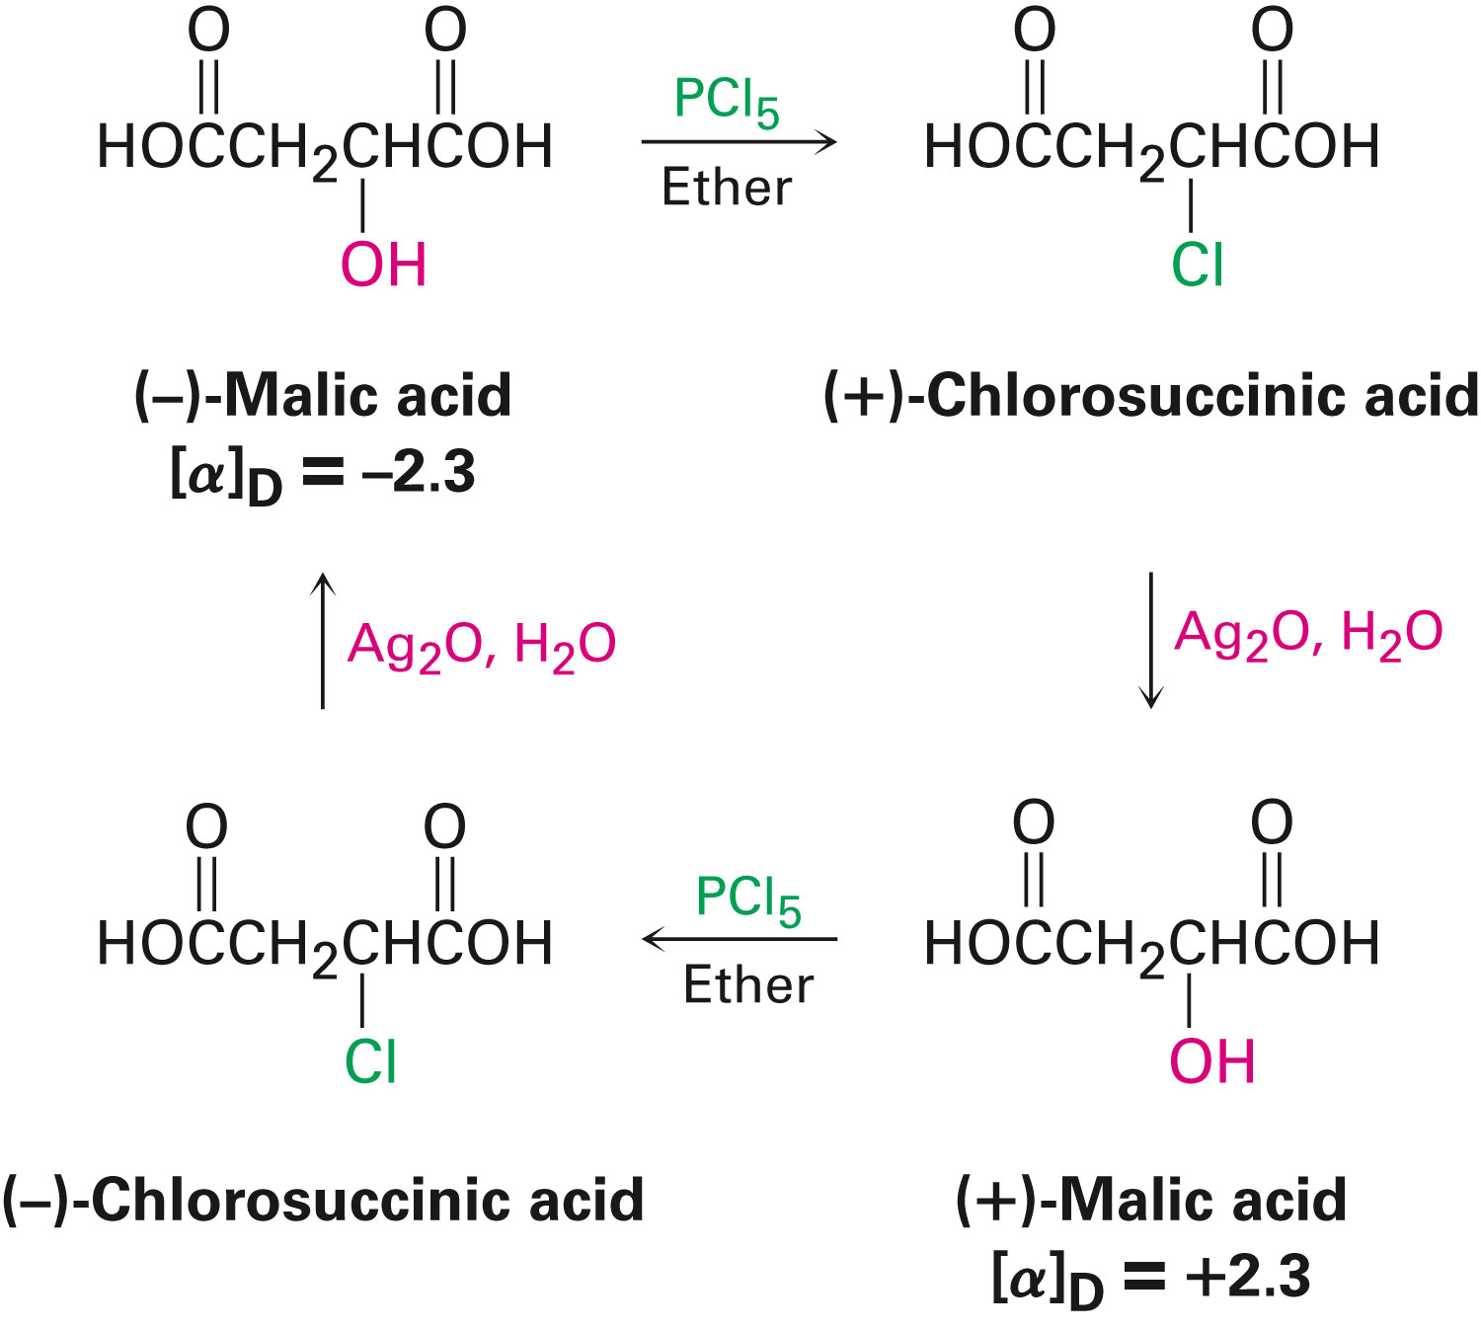
Figure 11.1 - Walden’s Cycle of Reactions Interconverting
Notes:
The discovery of nucleophilic substitution reactions

Slide 7
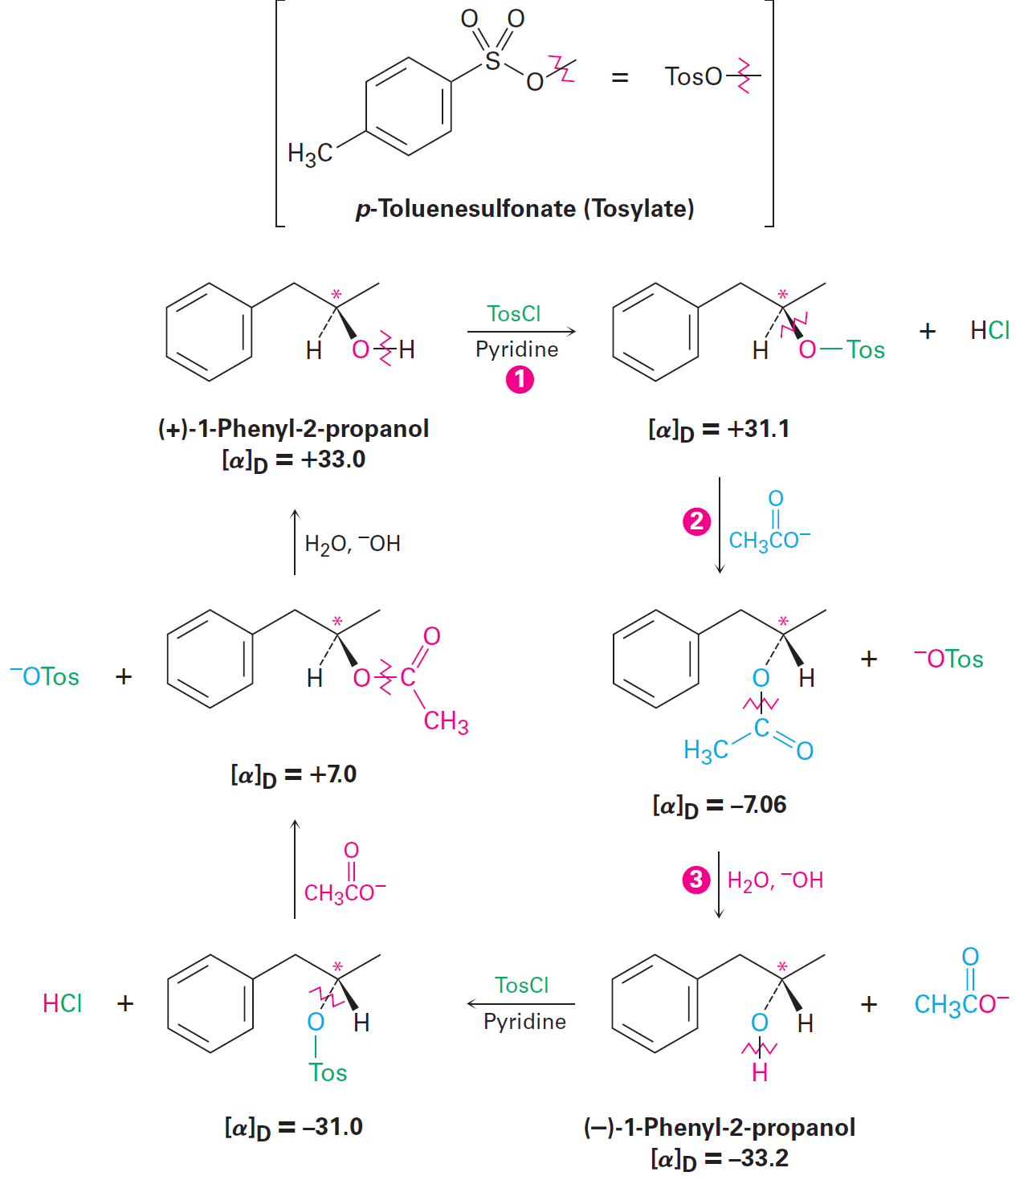
Figure 11.2 - Interconversion of (+) and (-) Enantiomers of 1-phenyl-2-propanol
Notes:
The discovery of nucleophilic substitution reactions

Slide 8
Worked Example
Mention the product of a nucleophilic substitution reaction of (S)-2-bromohexane with acetate ion, CH₃CO₂⁻
Assume that inversion of configuration occurs, and show the chemistry of both the reactant and product
Notes:
The discovery of nucleophilic substitution reactions

Slide 9
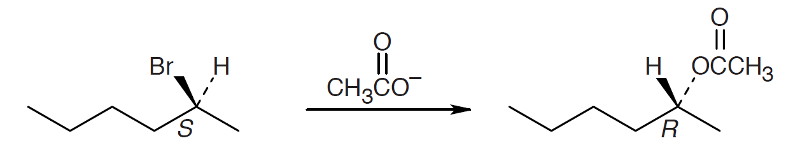
Worked Example
Solution:
Identify the leaving group and the chirality center
Draw the product carbon skeleton
Invert the configuration at the chirality center
Replace the leaving group (bromide) with the nucleophilic reactant (acetate)
Notes:
The discovery of nucleophilic substitution reactions

Slide 10
The S_{N}2 Reaction
Kinetics of a reaction refer to the concentrations of the reactants and the rate at which the reaction occurs
Second order reaction: A reaction in which the rate is linearly dependent on the concentration of the reactants
S_{N}2 reaction is short for substitution, nucleophilic, bimolecular
Notes:
The S_{N}2 reaction

Slide 11
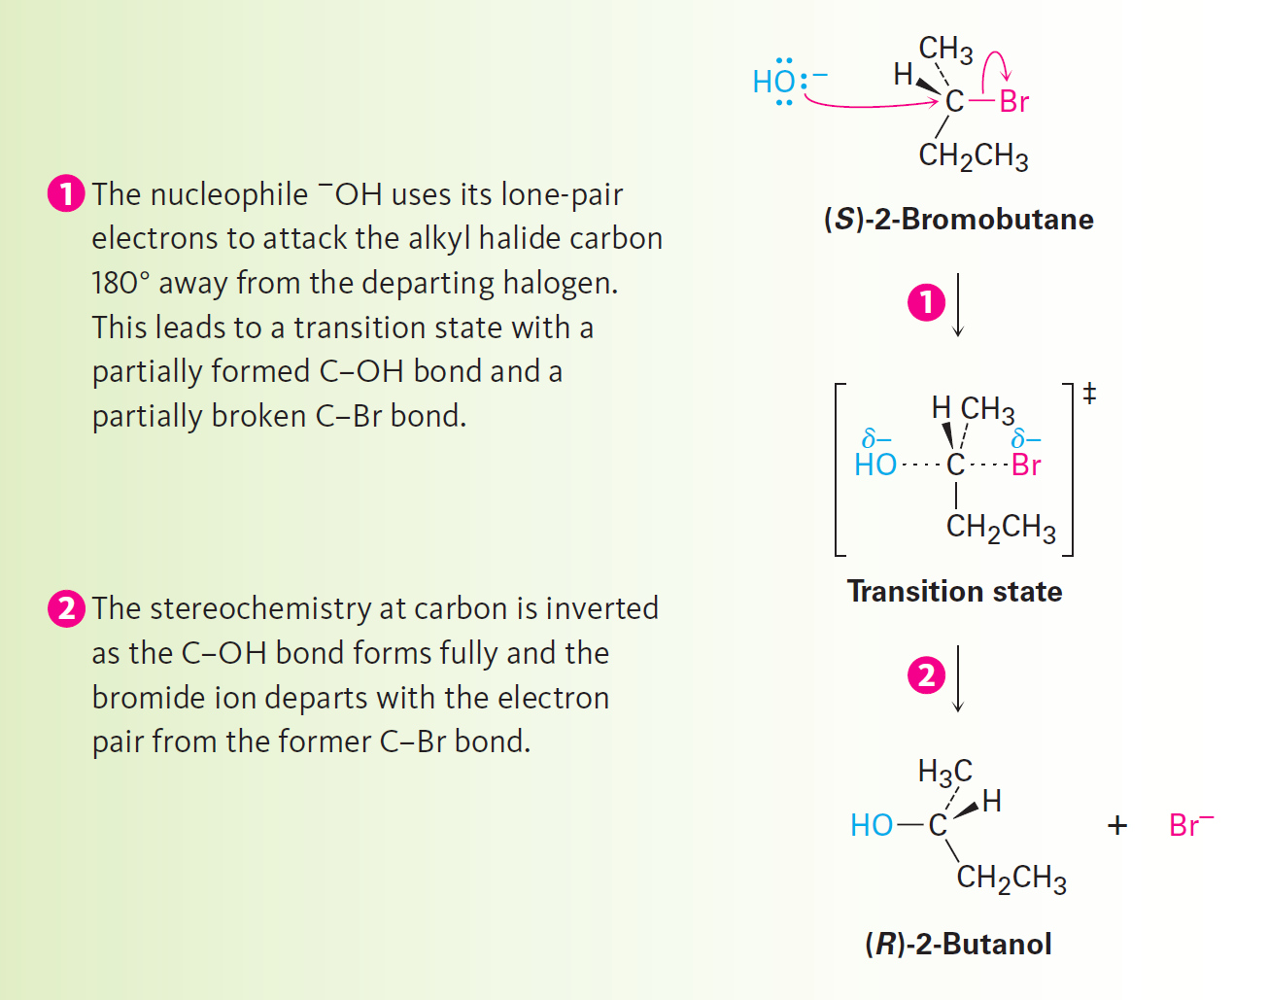
Figure 11.3 - Mechanism of the S_{N}2 Reaction
Example: for S converting to P
V = d[S]/dt = k [S]
Notes:
The S_{N}2 reaction

Slide 12
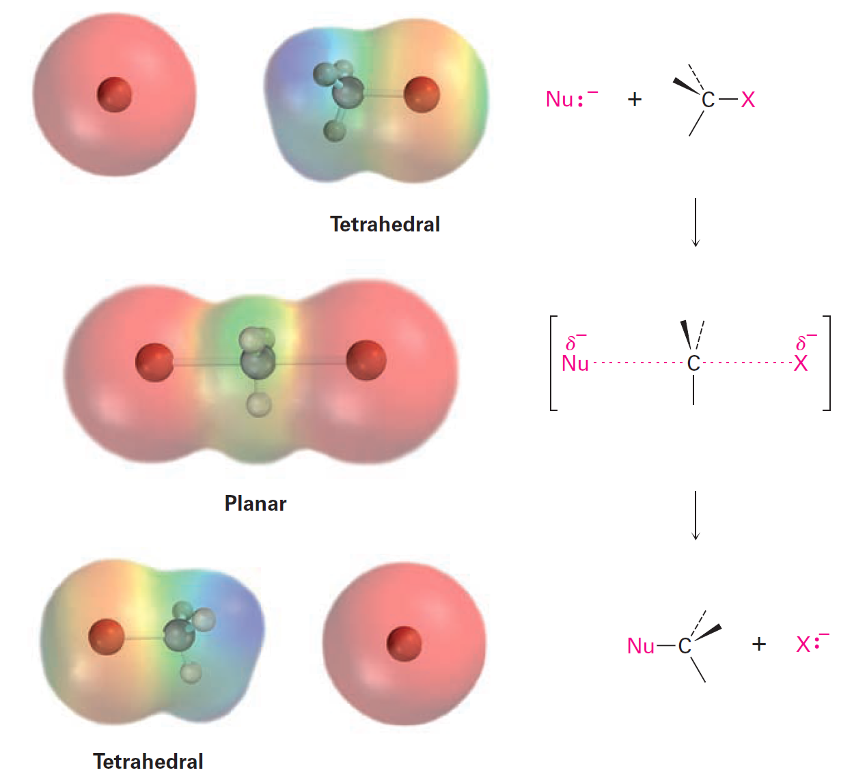
Figure 11.4 - Transition of an S_{N}2 Reaction
Notes:
The S_{N}2 reaction

Slide 13
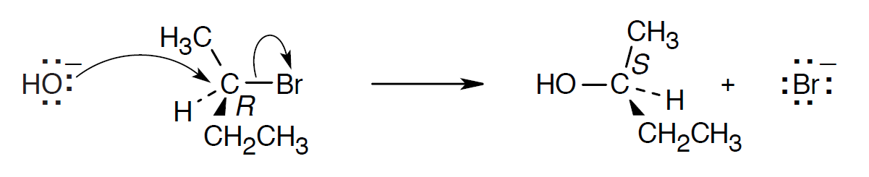
Worked Example
Mention the product obtained from the SN2 reaction of OH– with (R)-2-bromobutane
Show the chemistry of the reactant and the product
Solution:
Notes:
The S_{N}2 reaction

Slide 14
Characteristics of the S_{N}2 Reaction
Understanding of reaction rates is required
Activation energy, ΔG^{ǂ} , determines the rate of reaction
ΔG^{ǂ} is the energy difference between the reactant ground state and transition state
ΔG^{ǂ} is increased by a decrease in reactant energy or an increase in transition state energy
ΔG^{ǂ} is decreased by an increase in reactant energy or a decrease in transition state energy
Notes:
Characteristics of the S_{N}2 reaction

Slide 15
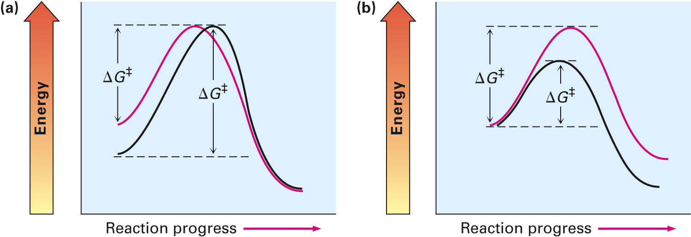
Figure 11.5 - The Effects of Changes in Reactant and Transition-State Energy Levels
Higher reactant energy level (red curve) = Faster reaction (smaller ΔG‡)
Higher transition state energy level (red curve) = Slower reaction (larger ΔG‡)
Notes:
Characteristics of the S_{N}2 reaction

Slide 16
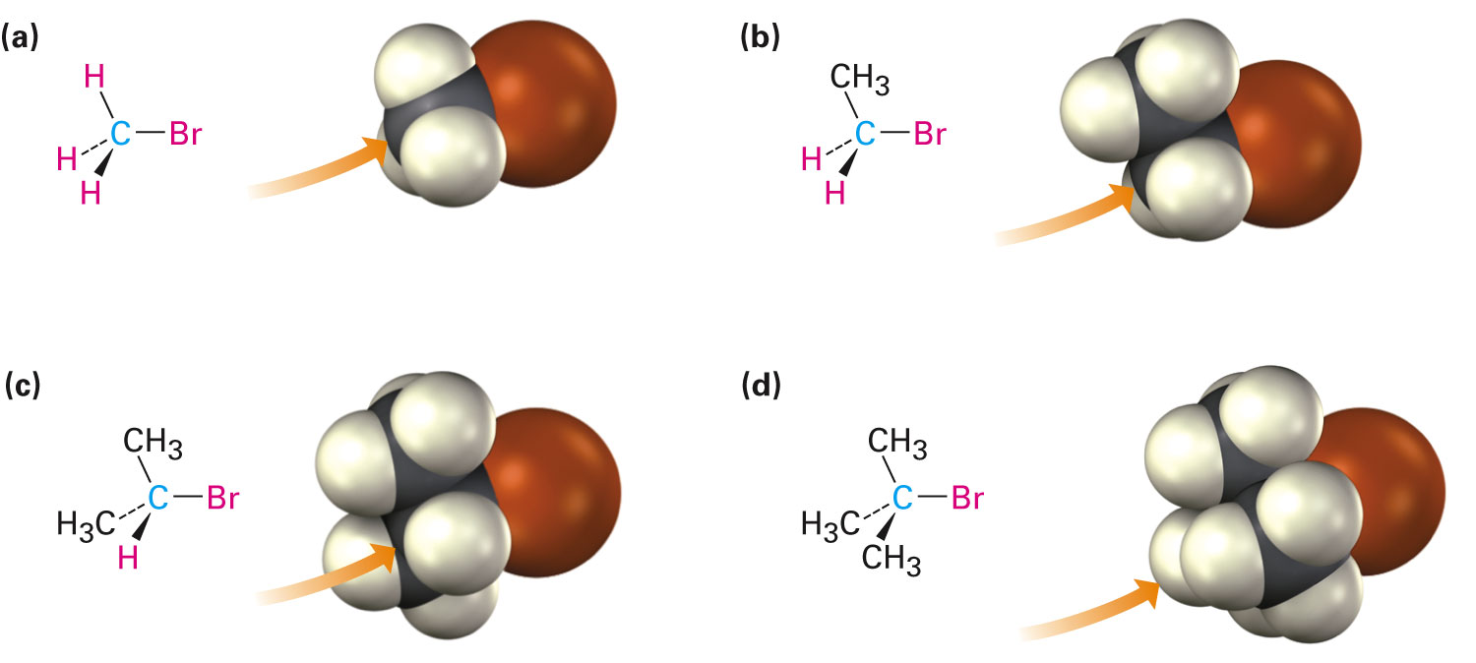
Steric Effects on S_{N}2 Reactions
Partial bond is formed between the incoming nucleophile and the alkyl halide carbon atom
Bond formation is difficult with the nucleophile
The substrate possesses a higher energy than a less hindered substrate
Notes:
Characteristics of the S_{N}2 reaction

Slide 17
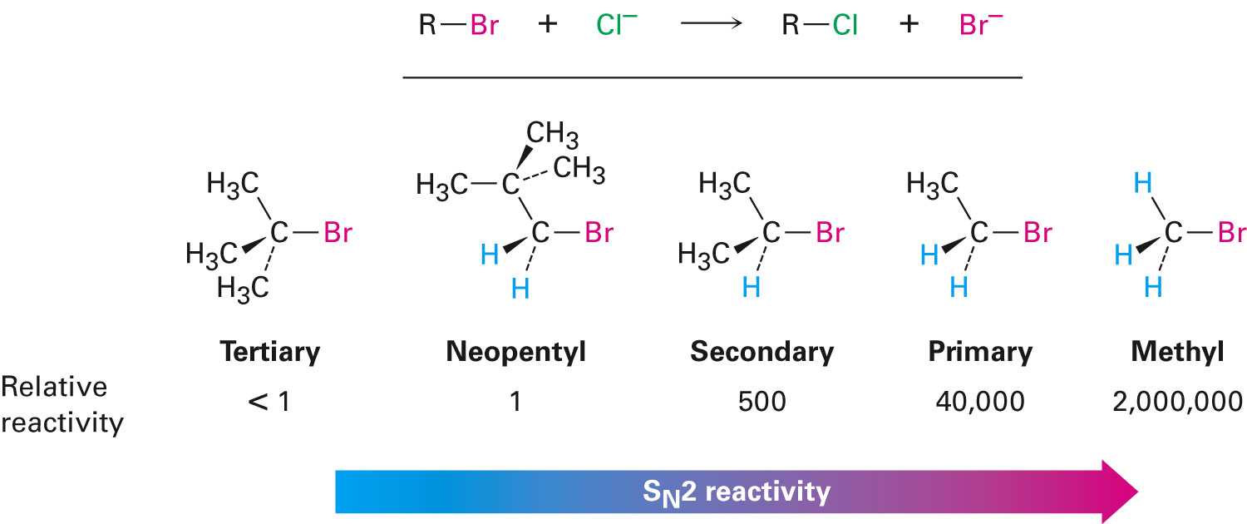
Order of Reactivity in S_{N}2
The more the alkyl groups connected to the reacting carbon, the slower the reaction
Notes:
Characteristics of the S_{N}2 reaction

Slide 18
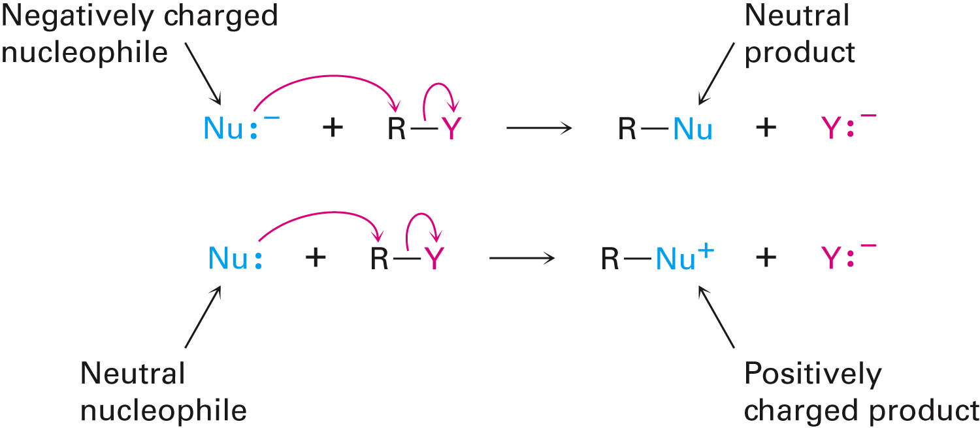
The Nucleophile
Neutral or negatively charged Lewis base
Negatively charged nucleophile yields a neutral product
Neutral nucleophile yields a positively charged product
Notes:
Characteristics of the S_{N}2 reaction

Slide 19
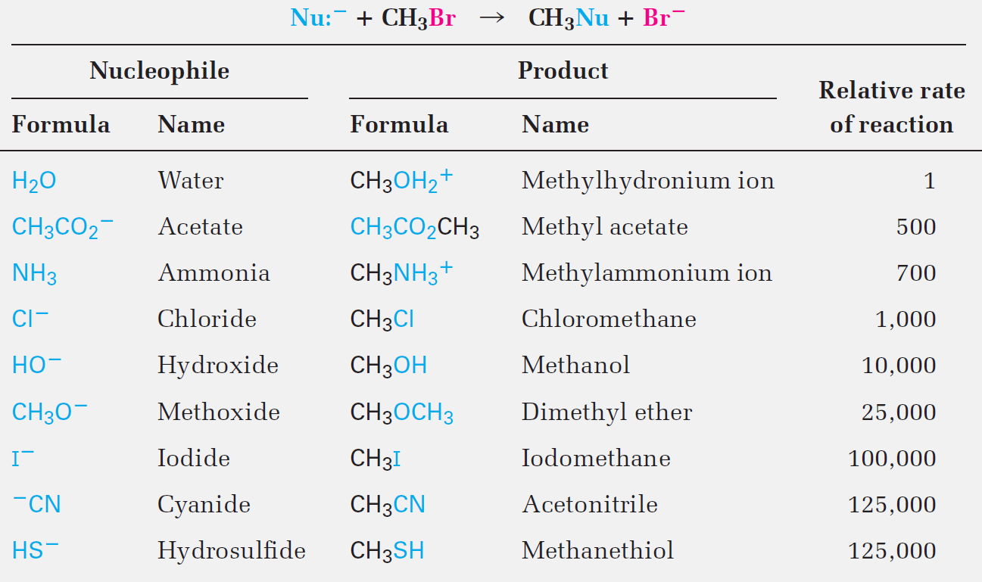
Table 11.1 - Some S_{N}2 Reactions With Bromo Ethane
Notes:
Characteristics of the S_{N}2 reaction

Slide 20
The Nucleophile
Based on the reactions of nucleophilic substances with bromoethane, some reactants seem to be more nucleophilic than others
Nucleophilicity is based on the concentration of the substrate, the solvent, and the reactant
Trends observed in nucleophiles:
Nucleophilicity roughly parallels basicity
Nucleophilicity increases with downward progression in the periodic table
Nucleophiles with a negative charge are generally more reactive than those that are neutral
Notes:
Characteristics of the S_{N}2 reaction

Slide 21
Worked Example
Mention the product formed in an S_{N}2 reaction between 1-bromobutane and NaI
Solution:
Notes:
Characteristics of the S_{N}2 reaction

Slide 22
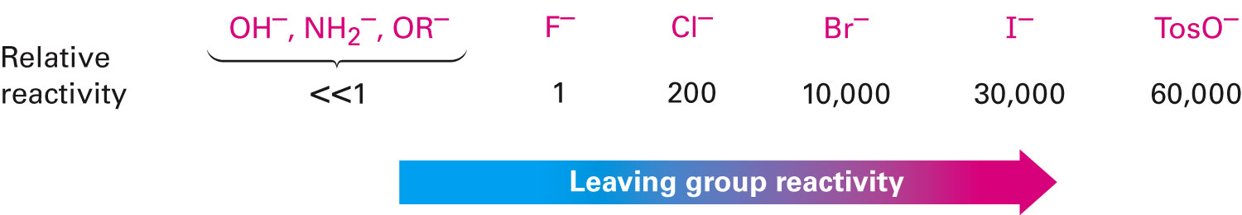
The Leaving Group
Group that is displaced by the incoming nucleophile in the S_{N}2 reaction
Leaving groups that provide optimal stability to the negative charge in the transition state are considered the best
Weak bases are good leaving groups, and strong bases are poor leaving groups
Notes:
Characteristics of the S_{N}2 reaction

Slide 23
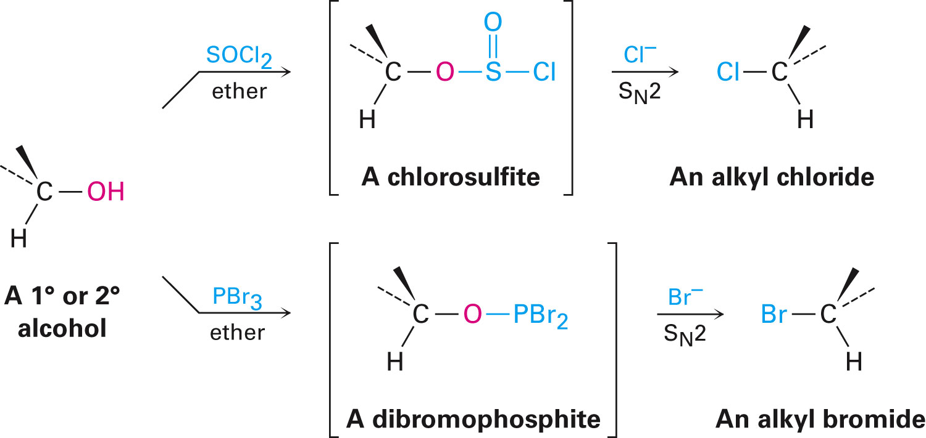
The Leaving Group
An S_{N}2 reaction with an alcohol requires conversion to an alkyl chloride or an alkyl bromide
Notes:
Characteristics of the S_{N}2 reaction

Slide 24
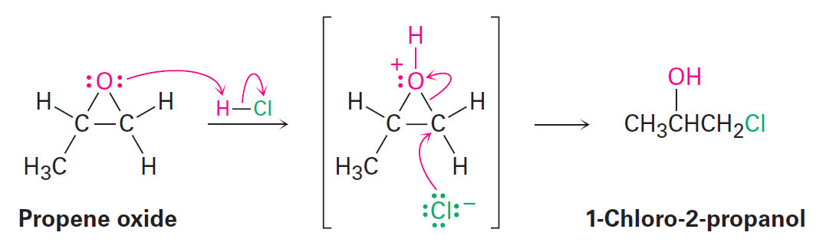
Poor Leaving Groups
Generally, ethers do not undergo S_{N}2 reactions
Epoxides are an exception as they are more reactive than ethers
Notes:
Characteristics of the S_{N}2 reaction

Slide 25
Worked Example
Rank the following compounds in order of their expected reactivity toward S_{N}2 reaction:
CH₃Br, CH₃OTos, (CH₃)₂CHCl
Notes:
Characteristics of the S_{N}2 reaction

Slide 26
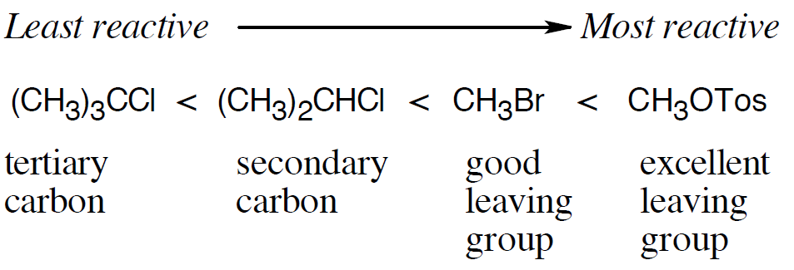
Worked Example
Solution:
With reference to effects of the substrate and the leaving group:
Reactivity of tertiary substrates is lesser than that of secondary substrates
Secondary substrates are less reactive than primary substrates
Notes:
Characteristics of the S_{N}2 reaction

Slide 27
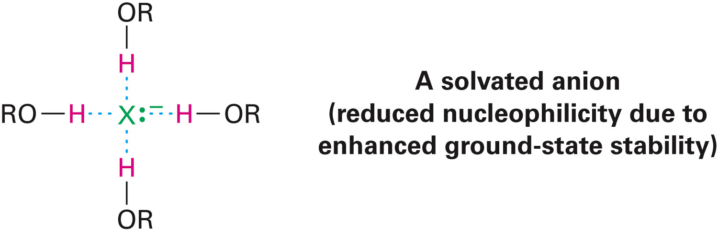
Influence of Solvents in the S_{N}2 Reaction
Poor solvents comprise an –OH or –NH group
Good solvents do not have an –OH or –NH group but are polar
Solvation: Process that occurs in the reactant nucleophile caused by protic solvents that slow the rate of S_{N}2 reactions
Notes:
Characteristics of the S_{N}2 reaction

Slide 28
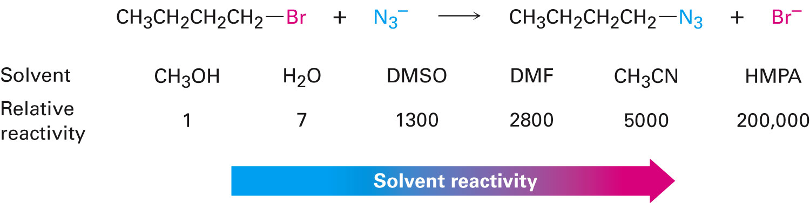
Influence of Solvents in the S_{N}2 Reaction
Polar aprotic solvents increase the rate of S_{N}2 reaction by increasing the ground energy of the nucleophile
High polarity gives it the ability to dissolve a number of salts, but they also dissolve metal cations instead of nucleophilic anions
Notes:
Characteristics of the S_{N}2 reaction

Slide 29
Worked Example
Discuss the effect of organic solvents such as benzene, ether, and chloroform on the reactivity of a nucleophile in S_{N}2 reactions
Notes:
Characteristics of the S_{N}2 reaction

Slide 30
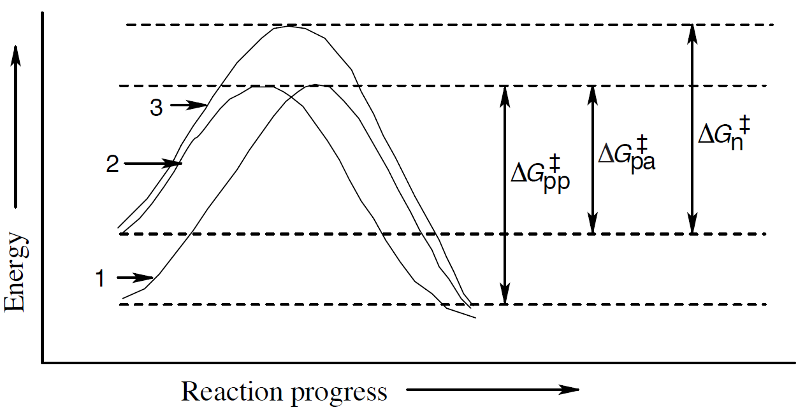
Worked Example
Solution:
Polar protic solvents (curve 1) stabilize the charged transition key by solvation and also stabilize the nucleophile by hydrogen bonding
Notes:
Characteristics of the S_{N}2 reaction

Slide 31
Worked Example
Polar aprotic agents (curve 2) stabilize the charged transition by isolation, but do not create a hydrogen-bond to the nucleophile
Nonpolar solvents (curve 3) stabilize neither the nucleophile nor the transition state
Notes:
Characteristics of the S_{N}2 reaction

Slide 32
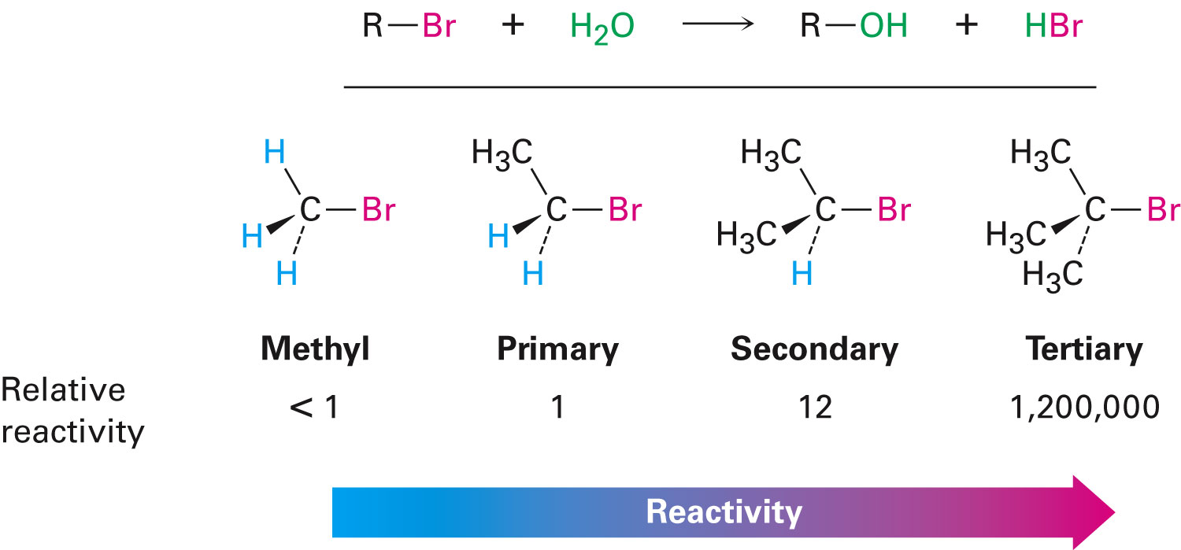
S_{N}1 Reaction
Nucleophilic substitution reaction by an alternative mechanism
S_{N}1 reaction: Substitution, nucleophilic, unimolecular
Tertiary alkyl halides react rapidly in protic solvents
Notes:
The S_{N}1 reaction

Slide 33
S_{N}1 Reaction
S_{N}1 reactions are first-order reactions
The rate equation does not contain the concentration of the nucleophile
Kinetics measurements
Rate-limiting step or rate-determining step - The step that has the highest energy transition state than other steps in an organic reaction
Notes:
The S_{N}1 reaction

Slide 34
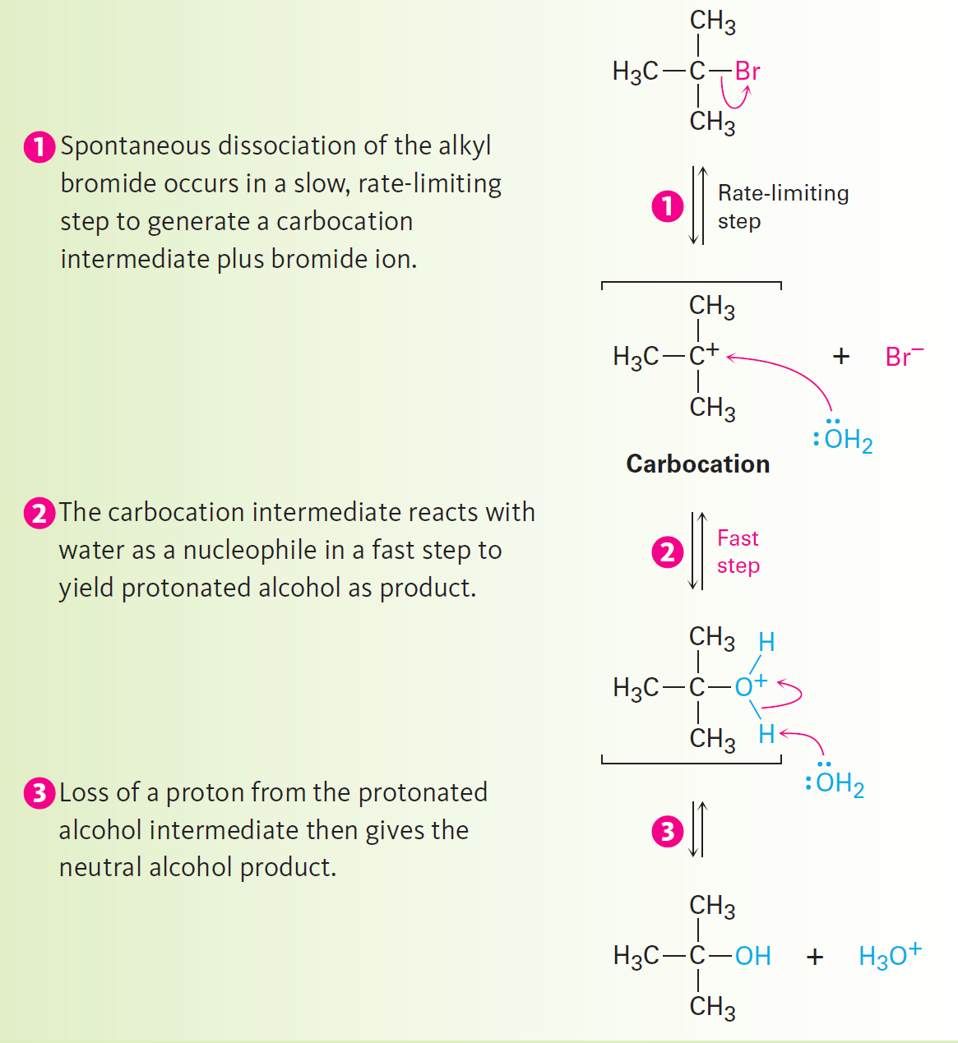
Figure 11.8 - Mechanism of the S_{N}1 Reaction
Notes:
The S_{N}1 reaction

Slide 35
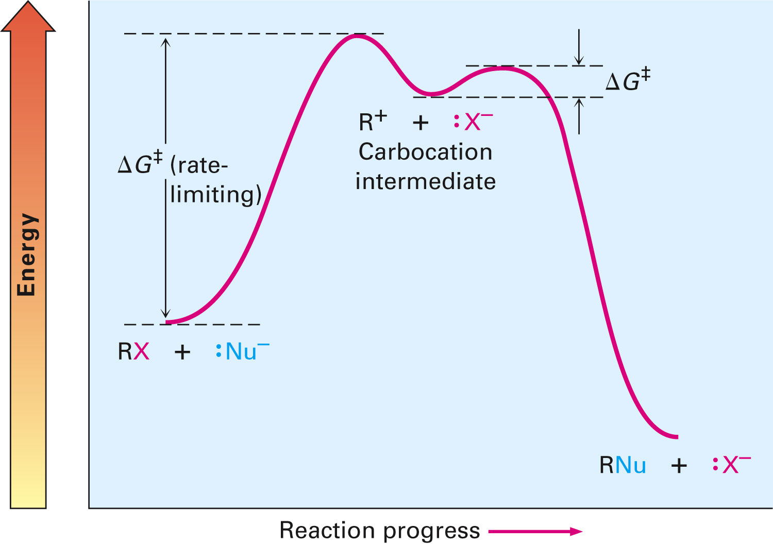
S_{N}1 Energy Diagram
Spontaneous dissociation of alkyl halide gives a carbocation intermediate
V = k[RX]
Notes:
The S_{N}1 reaction

Slide 36
S_{N}1 Reaction
Carbocation causes a difference in the stereochemical result of an S_{N}1 reaction as compared to an S_{N}2 reaction
Characteristics of carbocations:
Planar
sp²-hybridized
Achiral
A symmetric intermediate carbocation reacts with a nucleophile equally from either sides to produce a racemic, 50:50 enantiomer mixture
Notes:
The S_{N}1 reaction

Slide 37
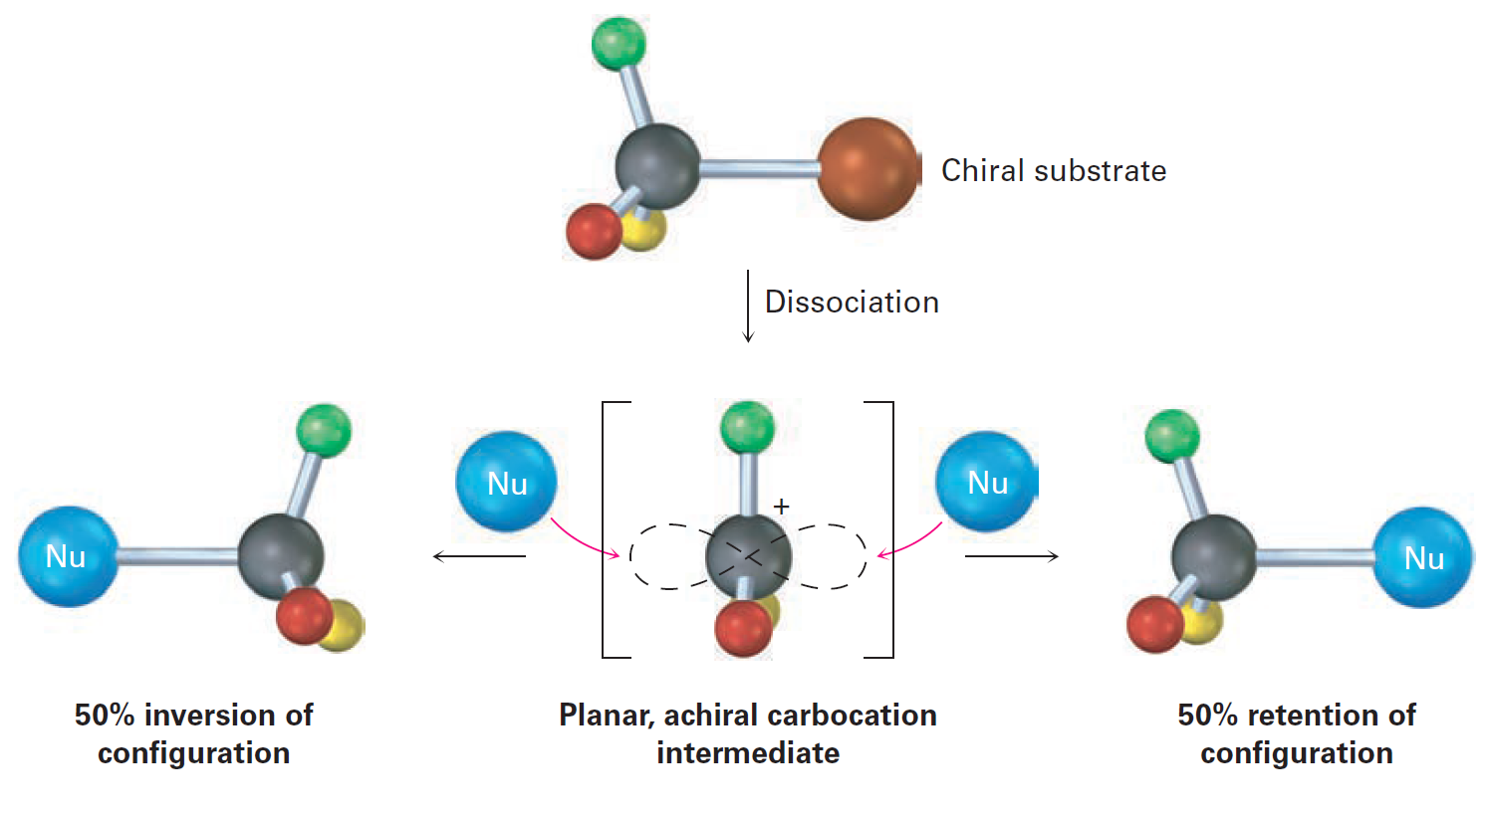
Figure 11.10 - Stereochemistry of the S_{N}1 Reaction
Notes:
The S_{N}1 reaction

Slide 38
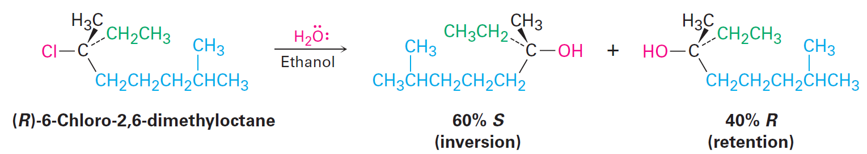
S_{N}1 Reaction
In some cases, S_{N}1 reactions with enantiomerically pure substrates result in racemization with an excess of 0–20%
Occurs due to the presence of ion pairs
Saul Winstein proposed that the presence of the two ions by dissociation of the substrate shields the carbocation at one side from reacting with the departing ion
Notes:
The S_{N}1 reaction

Slide 39
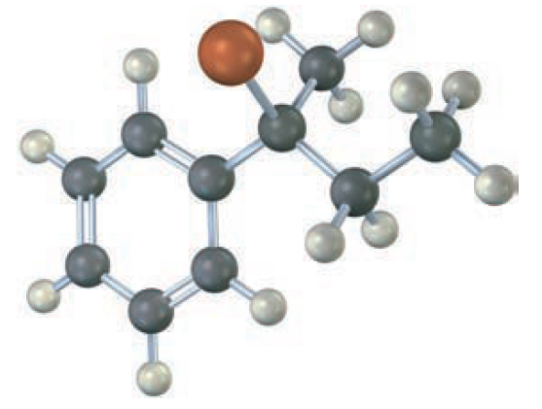
Worked Example
Configure the following substrate
Show the stereochemistry and identify the product that can be obtained by S_{N}1 reaction with water (reddish brown = Br)
Notes:
The S_{N}1 reaction

Slide 40
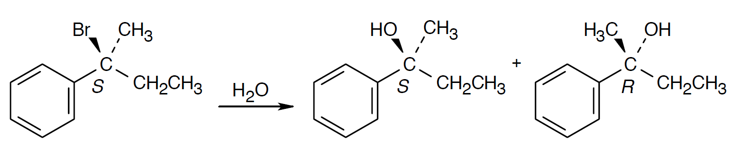
Worked Example
Solution:
The S substrate reacts with water to form a mixture of R and S alcohols
Ratio of enantiomers is close to 50:50
Notes:
The S_{N}1 reaction

Slide 41
Characteristics of the S_{N}1 Reaction
S_{N}1 reactions occur at a higher rate when ΔG^{ǂ} is decreased
Decreased energy level of the transition state
Increased energy level of the ground state
S_{N}1 reactions occur at a slower rate when ΔG^{ǂ} is increased
Increased energy level of the transition state
Decreased energy level of the ground state
Notes:
Characteristics of the S_{N}1 reaction

Slide 42
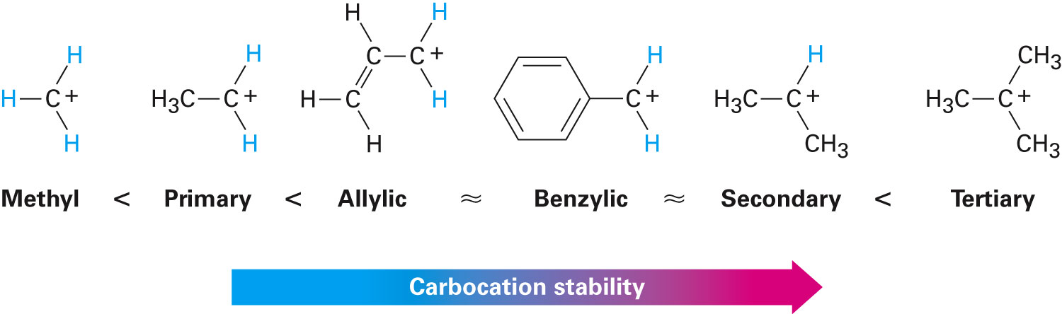
Influence of the Substrate on the S_{N}1 reaction
Hammond postulate - Any factor that stabilizes a high-energy intermediate also stabilizes transition state leading to that intermediate
Stability of the carbocation intermediate determines the rate of the S_{N}1 reaction
Includes the resonance-stabilized allyl and benzyl cations in the stability order of alkyl carbocations
Notes:
Characteristics of the S_{N}1 reaction

Slide 43
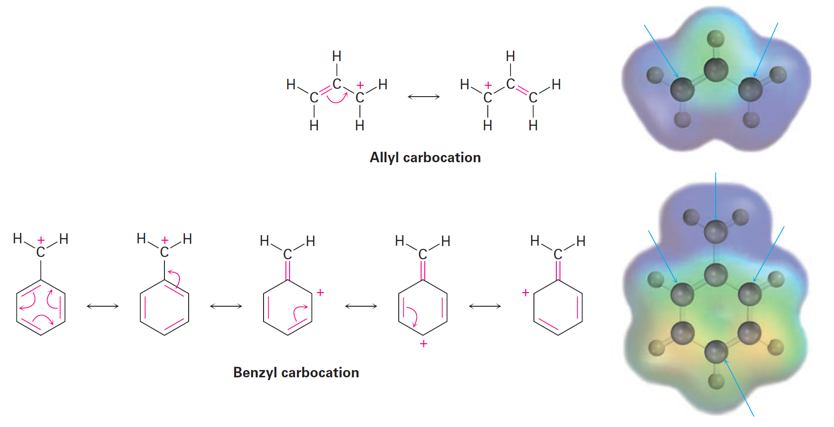
Figure 11.12 - Resonance Forms of Allylic and Benzylic Carbocations
Notes:
Characteristics of the S_{N}1 reaction

Slide 44
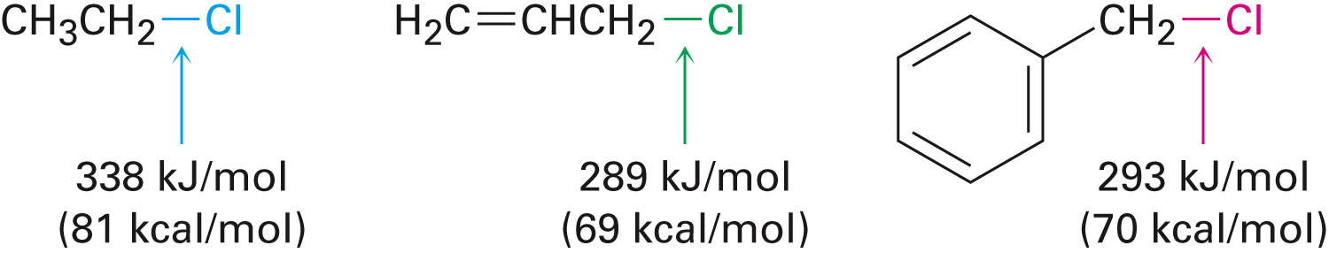
Allylic and Benzylic Halides
Primary allylic and benzylic substrates react well in both S_{N}2 and S_{N}1 reactions
Notes:
Characteristics of the S_{N}1 reaction

Slide 45
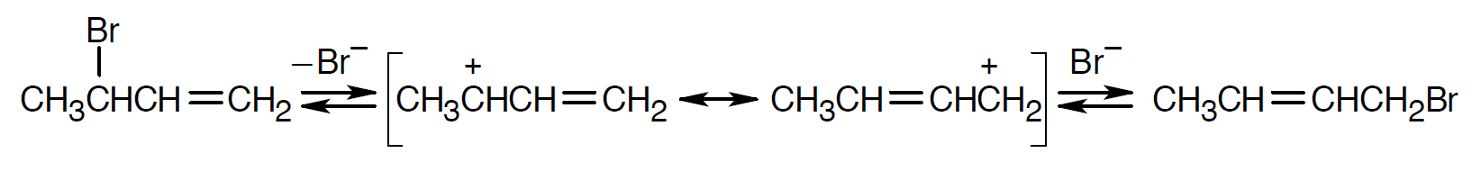
Worked Example
Explain why 3-Bromo-1-butane and 1-bromo-2-butane undergo S_{N}1 reaction at a similar rate, despite one being a secondary halide and the other being a primary halide
Solution:
The two bromobutenes form the same allylic carbocation in the rate limiting step
Notes:
Characteristics of the S_{N}1 reaction

Slide 46
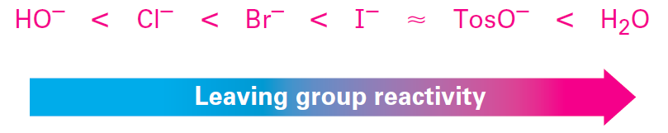
Effect of Leaving Group on S_{N}1
The influence of the leaving group in S_{N}1 reactions is similar to that of S_{N}2 reactions
The leaving group is closely associated with the rate-limiting step
Neutral water is the leaving group in S_{N}1 reactions occurring under acidic conditions
Notes:
Characteristics of the S_{N}1 reaction

Slide 47
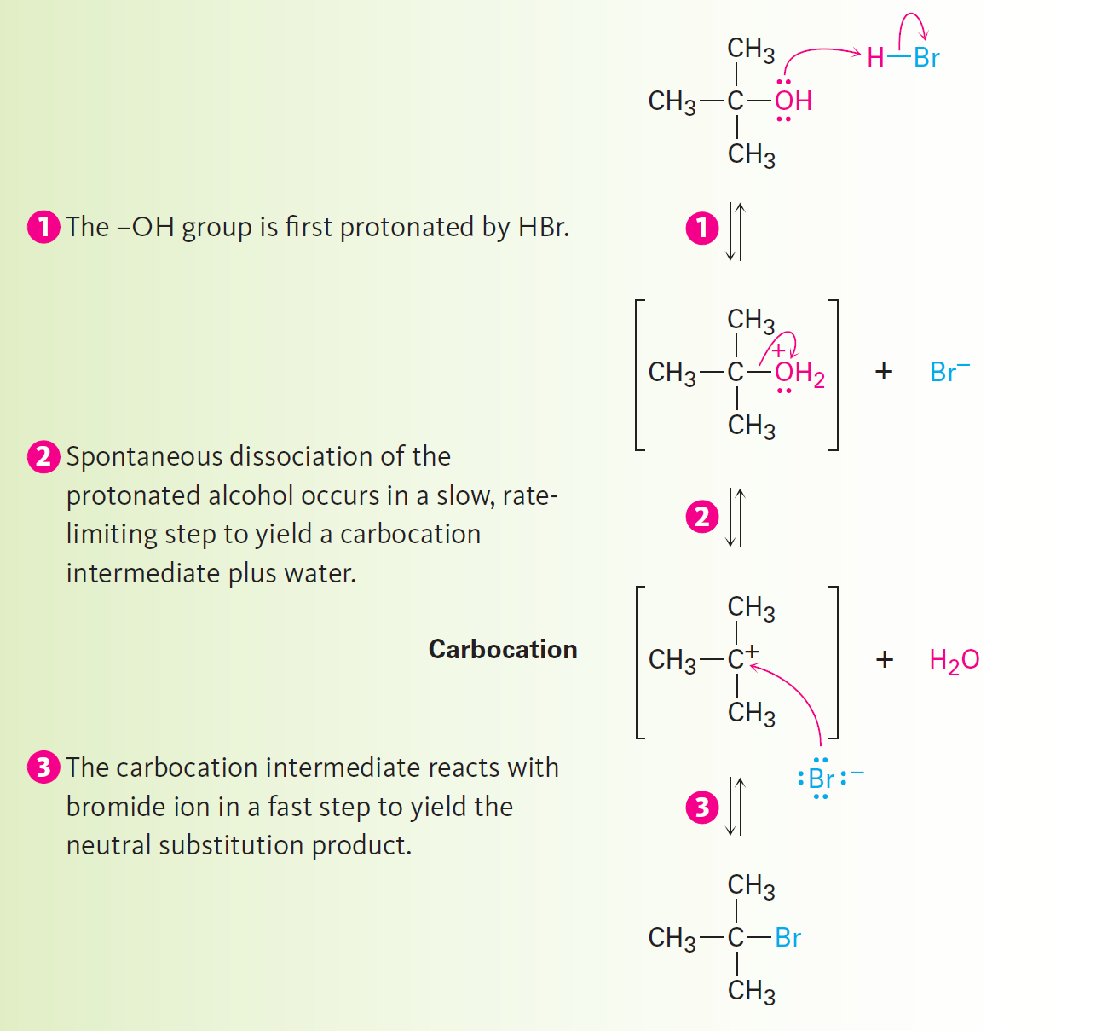
Figure 11.3 - Mechanism of the S_{N}1 Reaction
Notes:
Characteristics of the S_{N}1 reaction

Slide 48
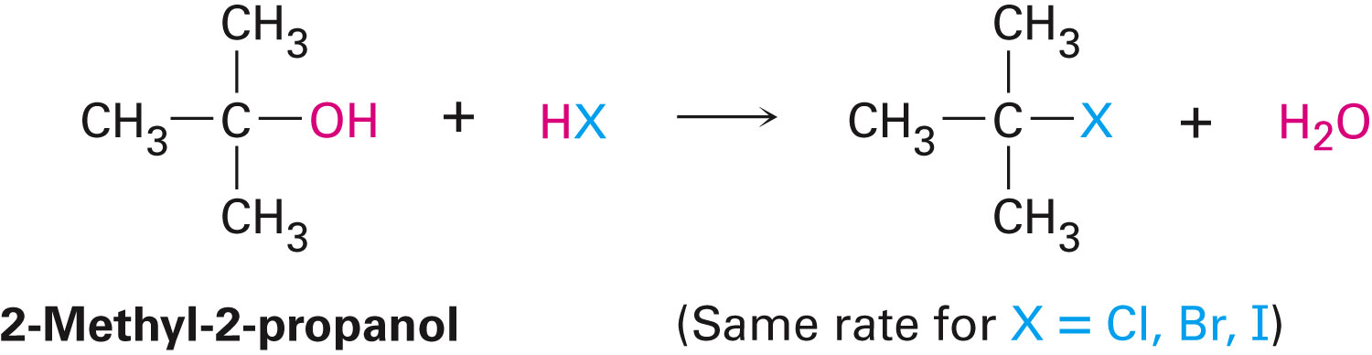
Effect of the Nucleophile in S_{N}1 Reaction
The added nucleophile is not associated with the rate-limiting method of the S_{N}1 reaction and hence has no influence on the reaction rate
Notes:
Characteristics of the S_{N}1 reaction

Slide 49
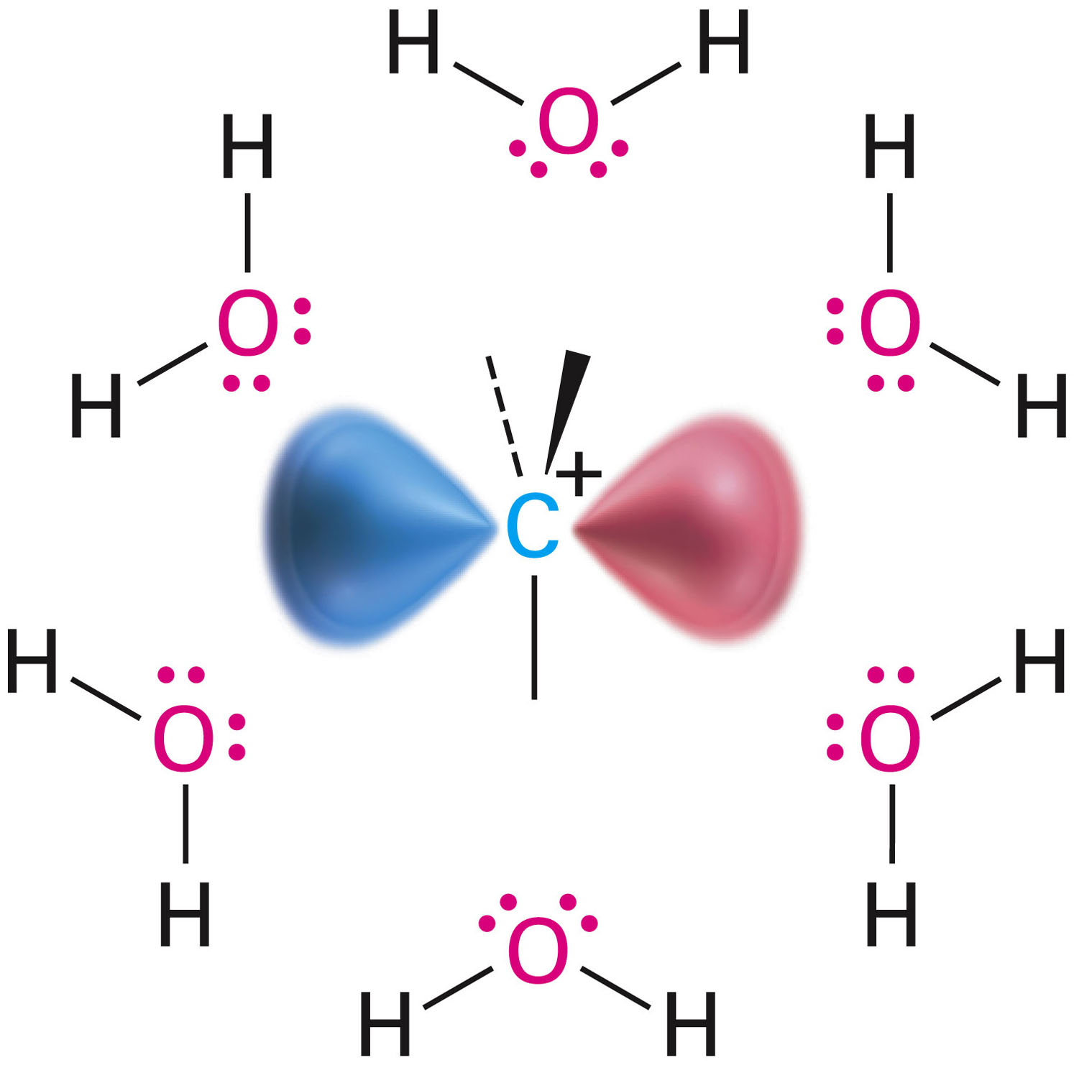
Effect of Solvent in S_{N}1 Reaction
According to the Hammond postulate, the factor that increases the rate of an S_{N}1 reaction also stabilizes the intermediate carbocation
Solvation of the carbocation is that factor
Notes:
Characteristics of the S_{N}1 reaction

Slide 50
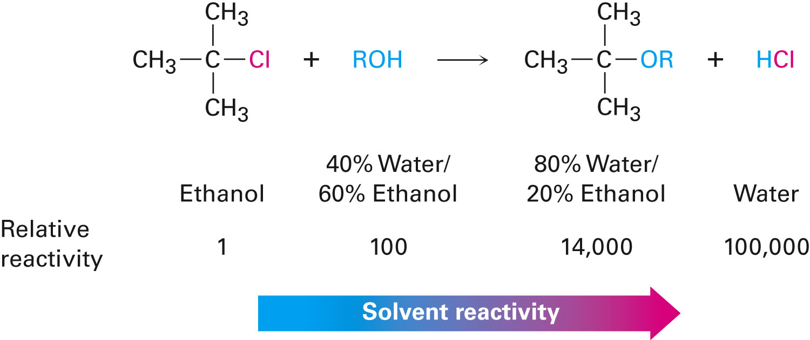
Effect of Solvent in S_{N}1 Reaction
S_{N}1 reactions have a faster rate in strongly polar solvents than in less polar solvents
Notes:
Characteristics of the S_{N}1 reaction

Slide 51
Effect of Solvent in S_{N}1 Reaction
Solvation by protic solvents decreases the ground-state energy of the nucleophile
Not optimal for S_{N}2 reactions
Solvation by protic solvents decreases the transition-state energy leading to carbocation intermediate
Favorable for S_{N}1 reactions
Notes:
Characteristics of the S_{N}1 reaction

Slide 52
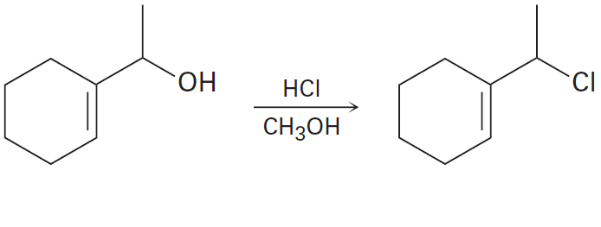
Worked Example
Predict whether the following substitution reaction is likely to be S_{N}1 or S_{N}2
Notes:
Characteristics of the S_{N}1 reaction

Slide 53
Worked Example
Solution:
This reaction probably occurs by an S_{N}1 mechanism
HCl converts the poor –OH leaving group into an excellent –OH₂⁺ leaving group, and the polar solvent stabilizes the carbocation intermediate
Notes:
Characteristics of the S_{N}1 reaction

Slide 54
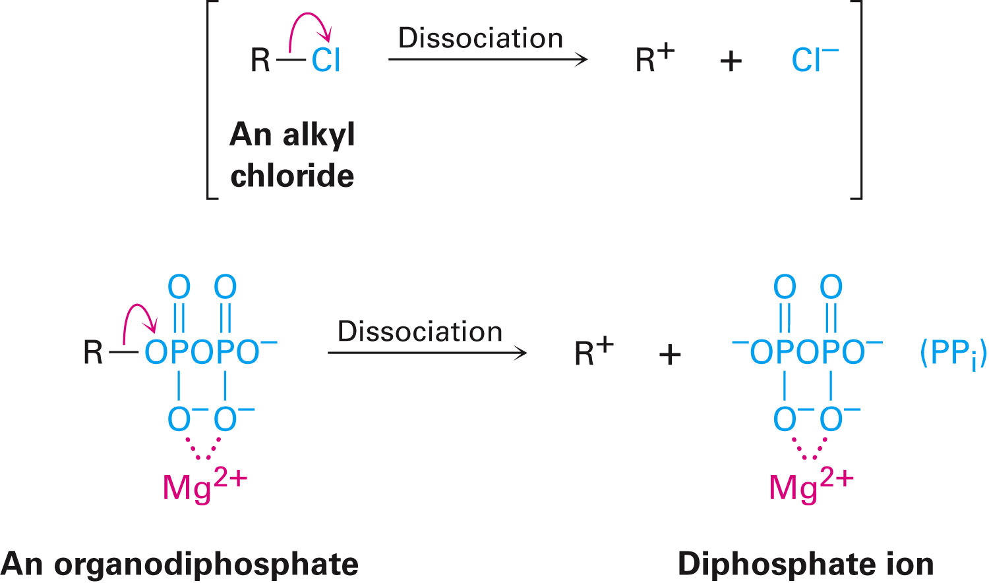
Biological Substitution Reactions
S_{N}1 and S_{N}2 reactions occur in the biosynthesis pathways of terpenoids
Biological substitution reactions use an organodiphosphate instead of an alkyl halide as the substrate
Notes:
Biological substitution reactions

Slide 55
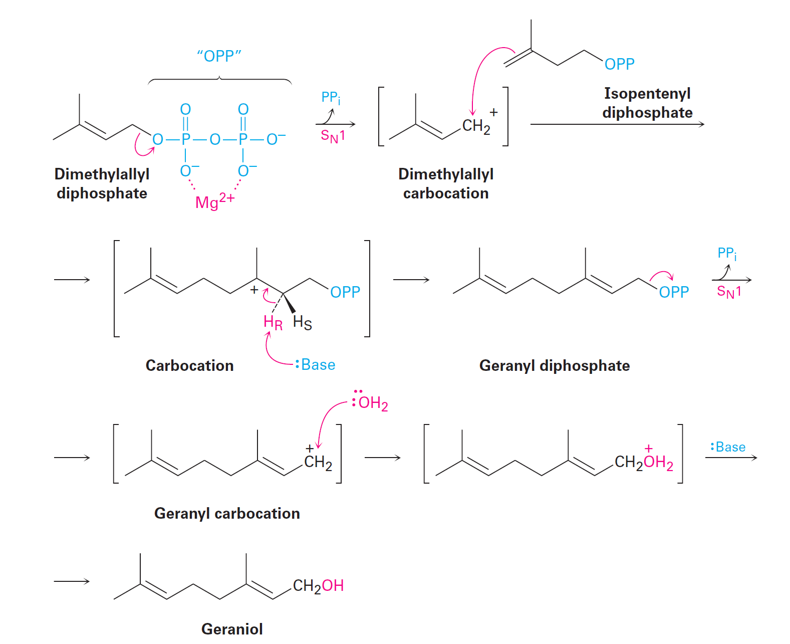
Figure 11.15 - Biosynthesis of Geraniol from Dimethyl
Notes:
Biological substitution reactions

Slide 56
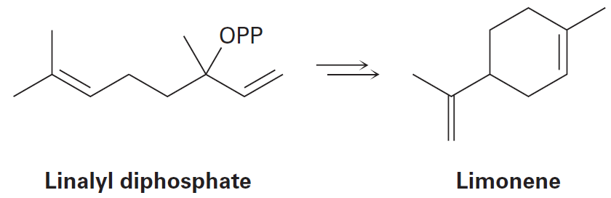
Worked Examples
Based on the mechanism of geraniol biosynthesis, propose a mechanism for the biosynthesis of limoene from linalyl diphosphate
Notes:
Biological substitution reactions

Slide 57
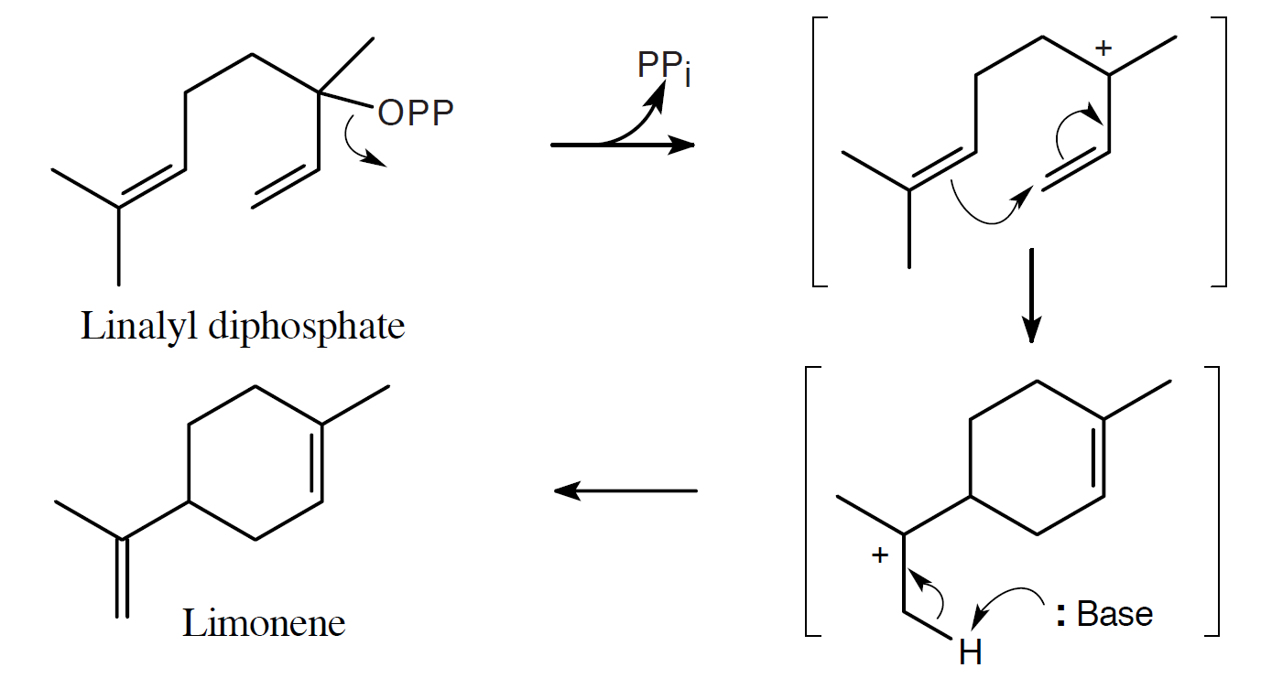
Worked Example
Solution:
After dissociation of PP_{i}, the cation cyclizes by attack of the double bond π electrons and –H is removed to yield limoene
Notes:
Biological substitution reactions

Slide 58
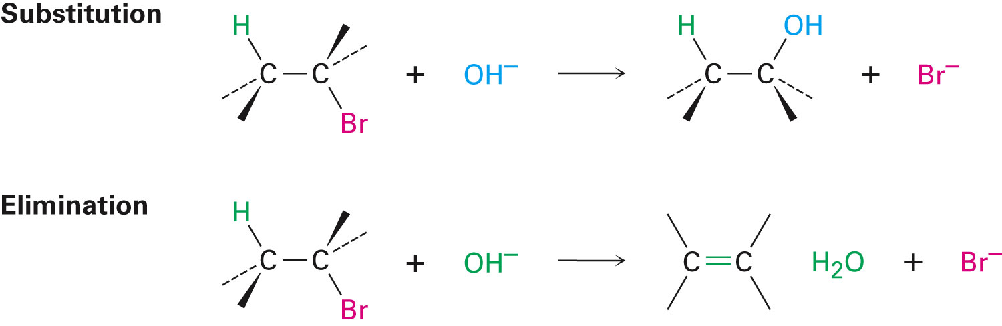
Elimination Reactions : Zaitsev’s Rule
A nucleophile/Lewis base reacts with an alkyl halide resulting in a substitution or an elimination
Notes:
Elimination reactions: Zaitsev’s rule

Slide 59
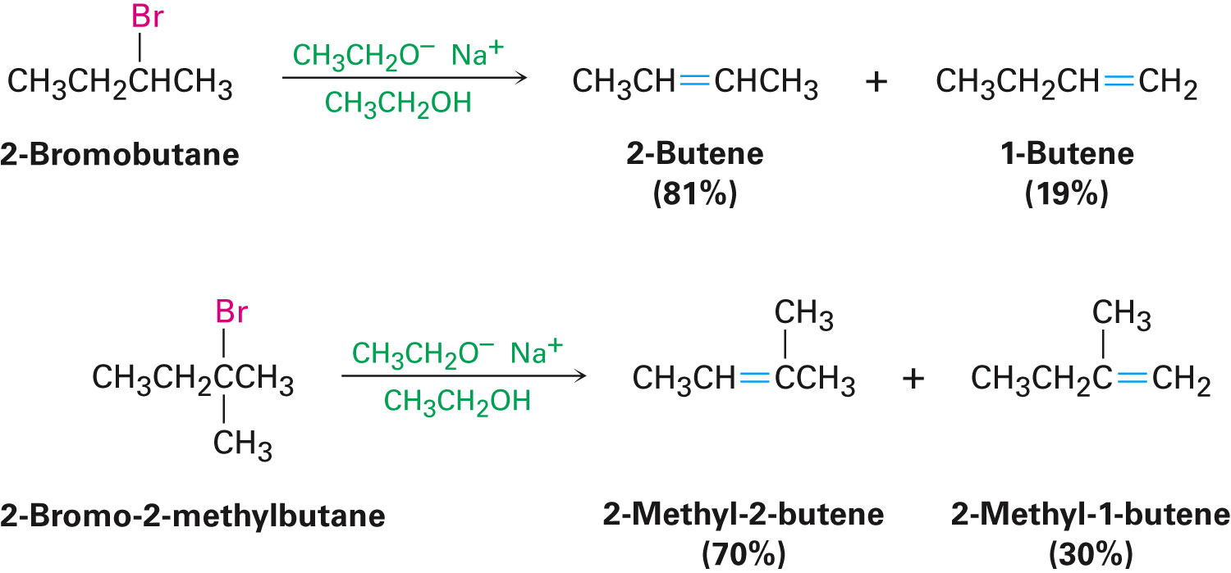
Zaitsev’s Rule for Elimination Reactions
In the elimination of HX from an alkyl halide, the more highly substituted alkene product predominates
Notes:
Elimination reactions: Zaitsev’s rule

Slide 60
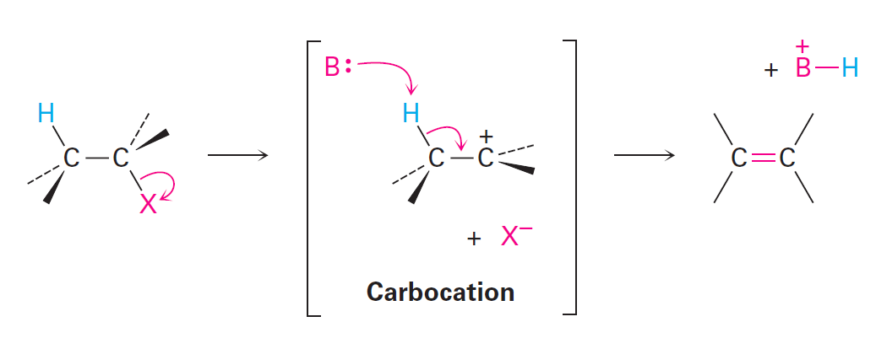
Mechanisms of Elimination Reactions
E1 reaction
Breaking of C–X bond produces a carbocation intermediate that yields the alkene by base removal of a proton
Notes:
Elimination reactions: Zaitsev’s rule

Slide 61
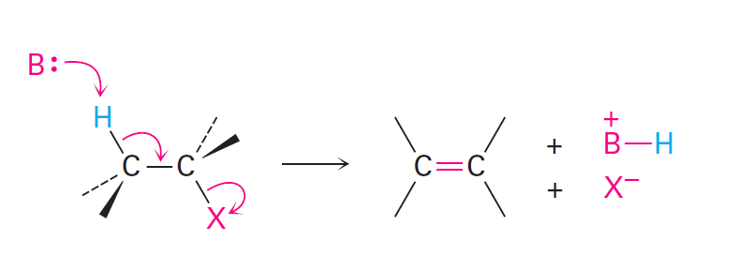
Mechanisms of Elimination Reactions
E2 reaction
Simultaneous cleavage of C–H bond and C–X bond produces the alkene without intermediates
Notes:
Elimination reactions: Zaitsev’s rule

Slide 62
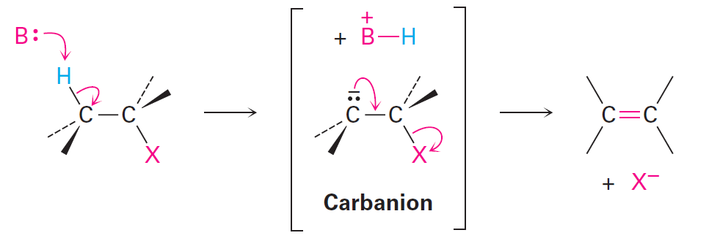
Mechanisms of Elimination Reactions
E1cB reaction
Proton undergoes base abstraction, yielding a carbanion (R⁻) intermediate
Carbanion loses X⁻, yielding the alkene
Notes:
Elimination reactions: Zaitsev’s rule

Slide 63
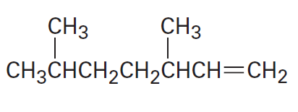
Worked Example
Mention the alkyl halide source of the following alkene
Notes:
Elimination reactions: Zaitsev’s rule

Slide 64
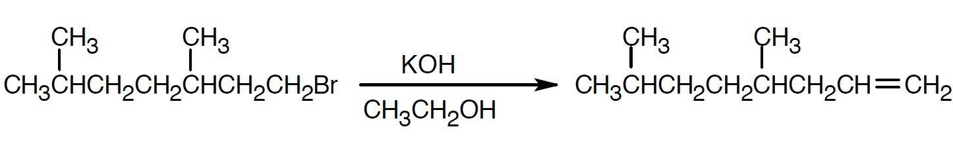
Worked Example
Solution:
For maximum yield, the alkyl halide reactant should not give a mixture of products on elimination
Notes:
Elimination reactions: Zaitsev’s rule

Slide 65
The E2 Reaction and the Deuterium Isotope Effect
E2 reaction: Reaction involving treatment of an alkyl halide with a strong base
The most common elimination pathway
Abides by the rate law
Rate = k ×[RX] ×[Base]
Deuterium isotope effect: C–H bond is more easily broken than a corresponding C–D bond
Notes:
The E2 reaction and the deuterium isotope effect

Slide 66
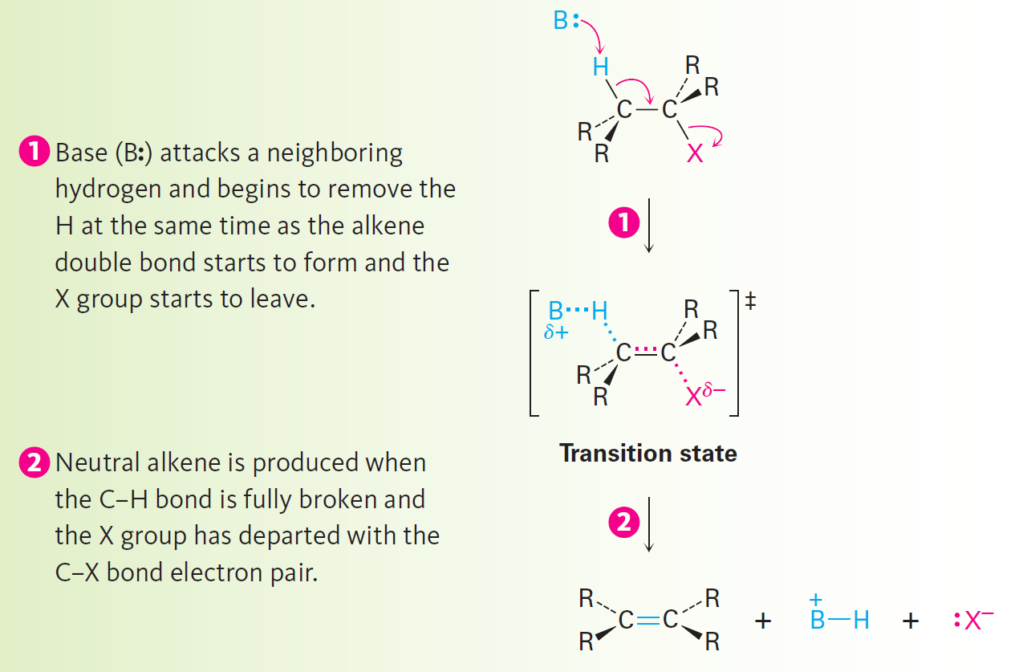
Figure 11.17 - Mechanism of the E2 Reaction with an Alkyl Halide
Notes:
The E2 reaction and the deuterium isotope effect

Slide 67
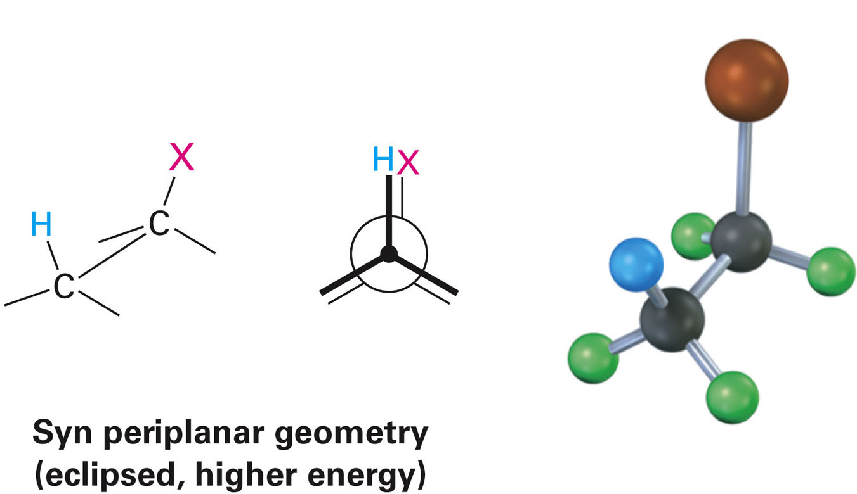
Geometry of Elimination - E2
Termed periplanar geometry
Hydrogen atom, the two carbons, and the leaving group lie in the same plane
Syn periplanar: H and X are on the same side of the molecule
Notes:
The E2 reaction and the deuterium isotope effect

Slide 68
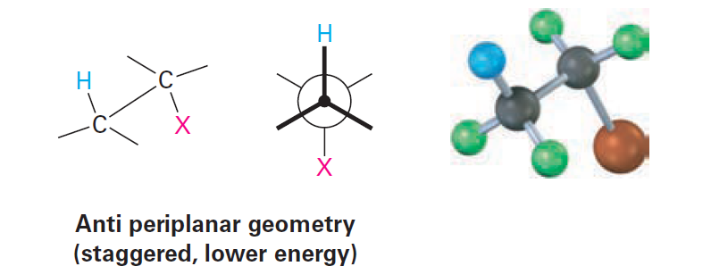
Geometry of Elimination - E2
Anti periplanar: H and X are on the opposite sides of the molecule
Notes:
The E2 reaction and the deuterium isotope effect

Slide 69
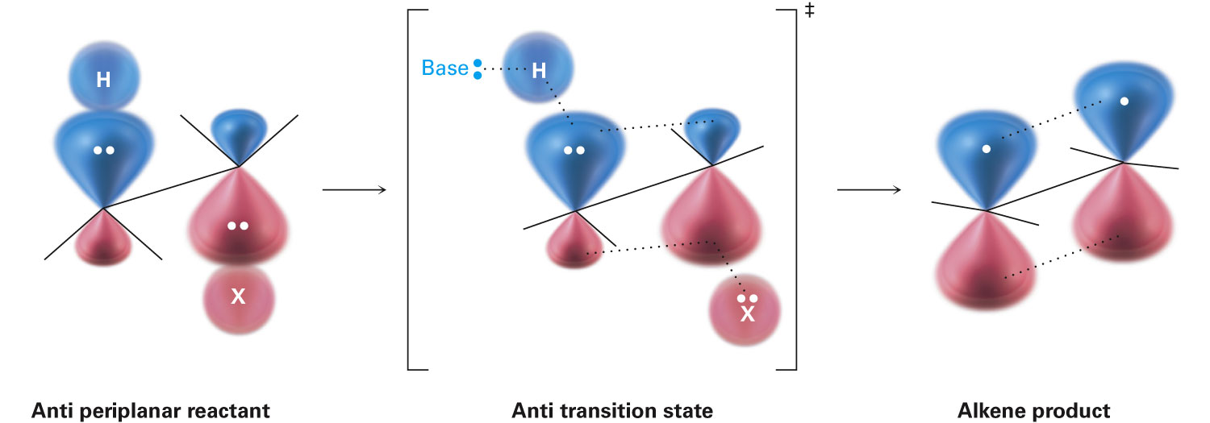

Significance of Periplanar Geometry
When all orbitals are periplanar, overlap in the transition state can easily occur
Notes:
The E2 reaction and the deuterium isotope effect

Slide 70

Geometry of Elimination - E2
E2 is stereospecific
Meso-1,2-dibromo-1,2-diphenylethane with base gives cis 1,2-diphenyl
RR or SS 1,2-dibromo-1,2-diphenylethane gives trans 1,2-diphenyl
Notes:
The E2 reaction and the deuterium isotope effect

Slide 71
Worked Example
Exhibit the stereochemistry of the alkene obtained by E2 elimination of (1R,2R)-1,2-dibromo-1,2-diphenylethane
Draw a Newman projection of the reacting confirmation
Notes:
The E2 reaction and the deuterium isotope effect

Slide 72


Worked Example
Solution:
The reactant with correct stereochemistry
The drawing converted into a Newman projection
Notes:
The E2 reaction and the deuterium isotope effect

Slide 73

Worked Example
The alkene resulting from E2 elimination is (Z)-1-bromo-1,2-diphenylethylene
Notes:
The E2 reaction and the deuterium isotope effect

Slide 74

The E2 Reaction and Cyclohexene Formation
Cyclohexane rings need to possess anti-planar geometry in order to undergo E2 reactions
Hydrogen and leaving group in cyclohexanes need to be transdiaxial
Notes:
The E2 Reaction and cyclohexane conformation

Slide 75
The E2 Reaction and Cyclohexane Formation
The trans-diaxial requirement is met in isomeric menthyl and neomethyl by the removal of HCl
HCl is removed from neomethyl chloride upon reaction with ethoxide ion
200 times faster than menthyl chloride
Conformations of methyl chloride and neomethyl chloride are responsible for the difference in reactivity
Notes:
The E2 Reaction and cyclohexane conformation

Slide 76

Figure 11.20 - Dehydrochlorination of Menthyl and Neo-Menthyl Chlorides
Notes:
The E2 Reaction and cyclohexane conformation

Slide 77
Worked Example
Between trans-1-bromo-4-tert-butylcyclohexane or cis-1-bromo-4-tert-butylcyclohexane, identify the isomer that undergoes E2 elimination at a faster rate
Draw each molecule in its more stable chair configuration and provide an explanation
Notes:
The E2 Reaction and cyclohexane conformation

Slide 78

Worked Example
Solution:
The larger tert-butyl group is always equatorial in the more stable conformation
The cis isomer reacts faster under E2 reactions because –Br and –H are in the anti periplanar arrangement that favors E2 elimination
Notes:
The E2 Reaction and cyclohexane conformation

Slide 79

The E1 and E1cB Reactions
E1 reaction: Comprises two steps and involves a carbocation
Notes:
The E1 and E1cB reactions

Slide 80

The E1 and E1cB Reactions
E1 reactions start out along the same lines as S_{N}1 reactions
Dissociation leads to loss of H⁺ from the neighboring carbon rather than substitution in S_{N}1 reactions
Substrates optimal for S_{N}1 reactions also work well for E1 reactions
Notes:
The E1 and E1cB reactions

Slide 81
Evidence Supporting E1 Mechanism
E1 reactions exhibit first-order kinetics that are consistent with a rate-limiting, unimolecular dissociation process
E1 reactions do not exhibit the deuterium isotope effect
Rate difference between a deuterated and nondeuterated substrate cannot be quantified
E1 reactions do not have specific geometric requirements like E2 reactions
Notes:
The E1 and E1cB reactions

Slide 82

Figure 11.22 - Eliminations of Menthyl Chloride
Notes:
The E1 and E1cB reactions

Slide 83

The E1cB Reaction
Takes place through a carbanion intermediate
Notes:
The E1 and E1cB reactions

Slide 84

Biological Elimination Reactions
Elimination reactions occur in biological pathways
E1cB is a common reaction
Eliminations convert 3-hydroxyl carbonyl compounds to unsaturated carbonyl compounds on a regular basis
Notes:
Biological elimination reactions

Slide 85
Summary of Reactivity: SN1, SN2, E1, E1cB, and E2
Primary alkyl halides
Use of a good nucleophile is required for S_{N}2 substitution
Strong hindered base is required for E2 elimination
Carbonyl group comprising a leaving group two carbons away is required for E1cB elimination reactions
Secondary alkyl halides
Nucleophile in a protic solvent is necessary for S_{N}2 substitution
Notes:
A summary of reactivity: S_{N}1, S_{N}2, E1, E1cB, and E2

Slide 86
Summary of Reactivity: SN1, SN2, E1, E1cB, E2
A strong base is required for E2 elimination reactions
Carbonyl group comprising a leaving group two carbons away is required for E1cB elimination reactions
Teritary alkyl halides
A base is necessary for E2 eliminations
Use of pure ethanol or water favors simultaneous S_{N}1 substitution and E1 elimination
Carbonyl group comprising a leaving group two carbons away is required for E1cB elimination reactions
Notes:
A summary of reactivity: S_{N}1, S_{N}2, E1, E1cB, and E2

Slide 87

Worked Example
Classify the following reaction as an SN1, Sn2, E1, E1cB, or E2 reaction
Solution:
This is an E1cB reaction as the leaving group is two carbons away from a carbonyl group
Notes:
A summary of reactivity: S_{N}1, S_{N}2, E1, E1cB, and E2

Slide 88
Summary
An S_{N}2 reaction is a second-order reaction characterized by an umbrella-like inversion at the carbon atom caused by the method of approach of the entering nucleophile
S_{N}1 reactions are first-order reactions characterized by dissociation to a carbocation by a slow, rate-limiting step
Elimination of alkyl halides occur by E2, E1, and E1cB reactions

Slide 89
Summary
In an antiperiplanar transition, the hydrogen, two carbons, and the leaving group are in the same plane
E2 reactions are characterized by a deuterium isotope effect and follows Zaitsev’s rule

